Slide 1

SIWES TECHNICAL REPORT
Done at Neo Cloud Technologies
Created by Chukwu Daniel Nonso

Slide 2
Table of Content
1. About Neo Cloud Technology
2. Experience at NCT
The Internship Program
Health Care System Development
Company’s Website
3. Department of Placement
4. Skills Acquired
5. Projects I worked on
6. Takeaways
7. Conclusion

Slide 3
About Neo Cloud Technologies
Neo Cloud Technologies (NCT) is a multi-product IT firm that provides creative and technology services across various sectors.
NCT focuses on delivering outstanding experiences for its clients, fostering a culture of ongoing learning through there collaborations with solution and education providers.
NCT largely trains newbies in tech and helps them take there skill from a beginner level to an intermediate level on whatever technology they are interested in.

Slide 4

Experience at NCT

Slide 5
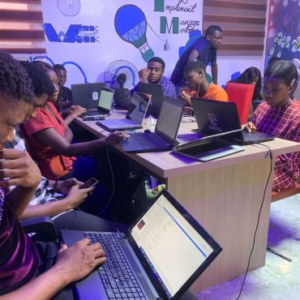
The Internship Program
Upon resumption to work as newly received interns, we were allowed to enroll in any area of tech we were interested in.
Some of the areas where:
UI/UX, Cloud Computing (AWS),
Backend Development, Data Analysis,
Web Development, Mobile Development, Networking, Cyber Security and so on.

Slide 6
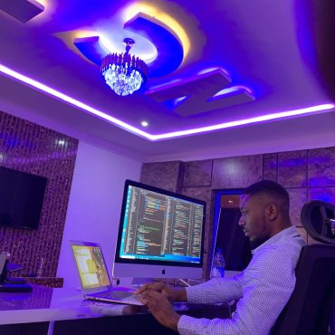
Health Care System Dev.
The company was contracted a job by the Imo State Government to build a health care system that could potentially be used by all the hospitals in the state.
I was fortunate enough to experience some part of the development process.
The system currently has over 12,000 records of newly signed in users and over 3,000 active users.

Slide 7
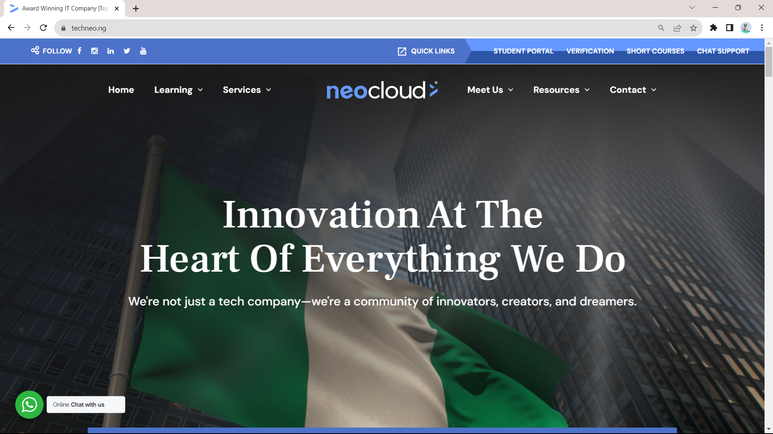
Company’s Website
During my time at the company I was also able to see them go through the process of revamping there entire website.
I was able to gain first-hand practical experience on the importance of planning big projects out (or to an extent at least) before jumping into them.
And also the importance of PHP and wordpress in delivering applications speedily. Prior to the program I used to not regard PHP.

Slide 8
Department of Placement
Mobile App Development (using Flutter)
Backend Development (using Node.js, GraphQL)

Slide 9
Skills Acquired
Mobile Development using Flutter
Clean Architecture
TDD
NoSQL databases using MongoDB
Database Design
Node JS for Backend Development
Apollo GraphQL
Figma

Slide 10
Projects I Worked On
Portfolio Website
A Note Taking Web Application
Neo Cloud Mobile Application
Neo Cloud Mobile Application Backend

Slide 11
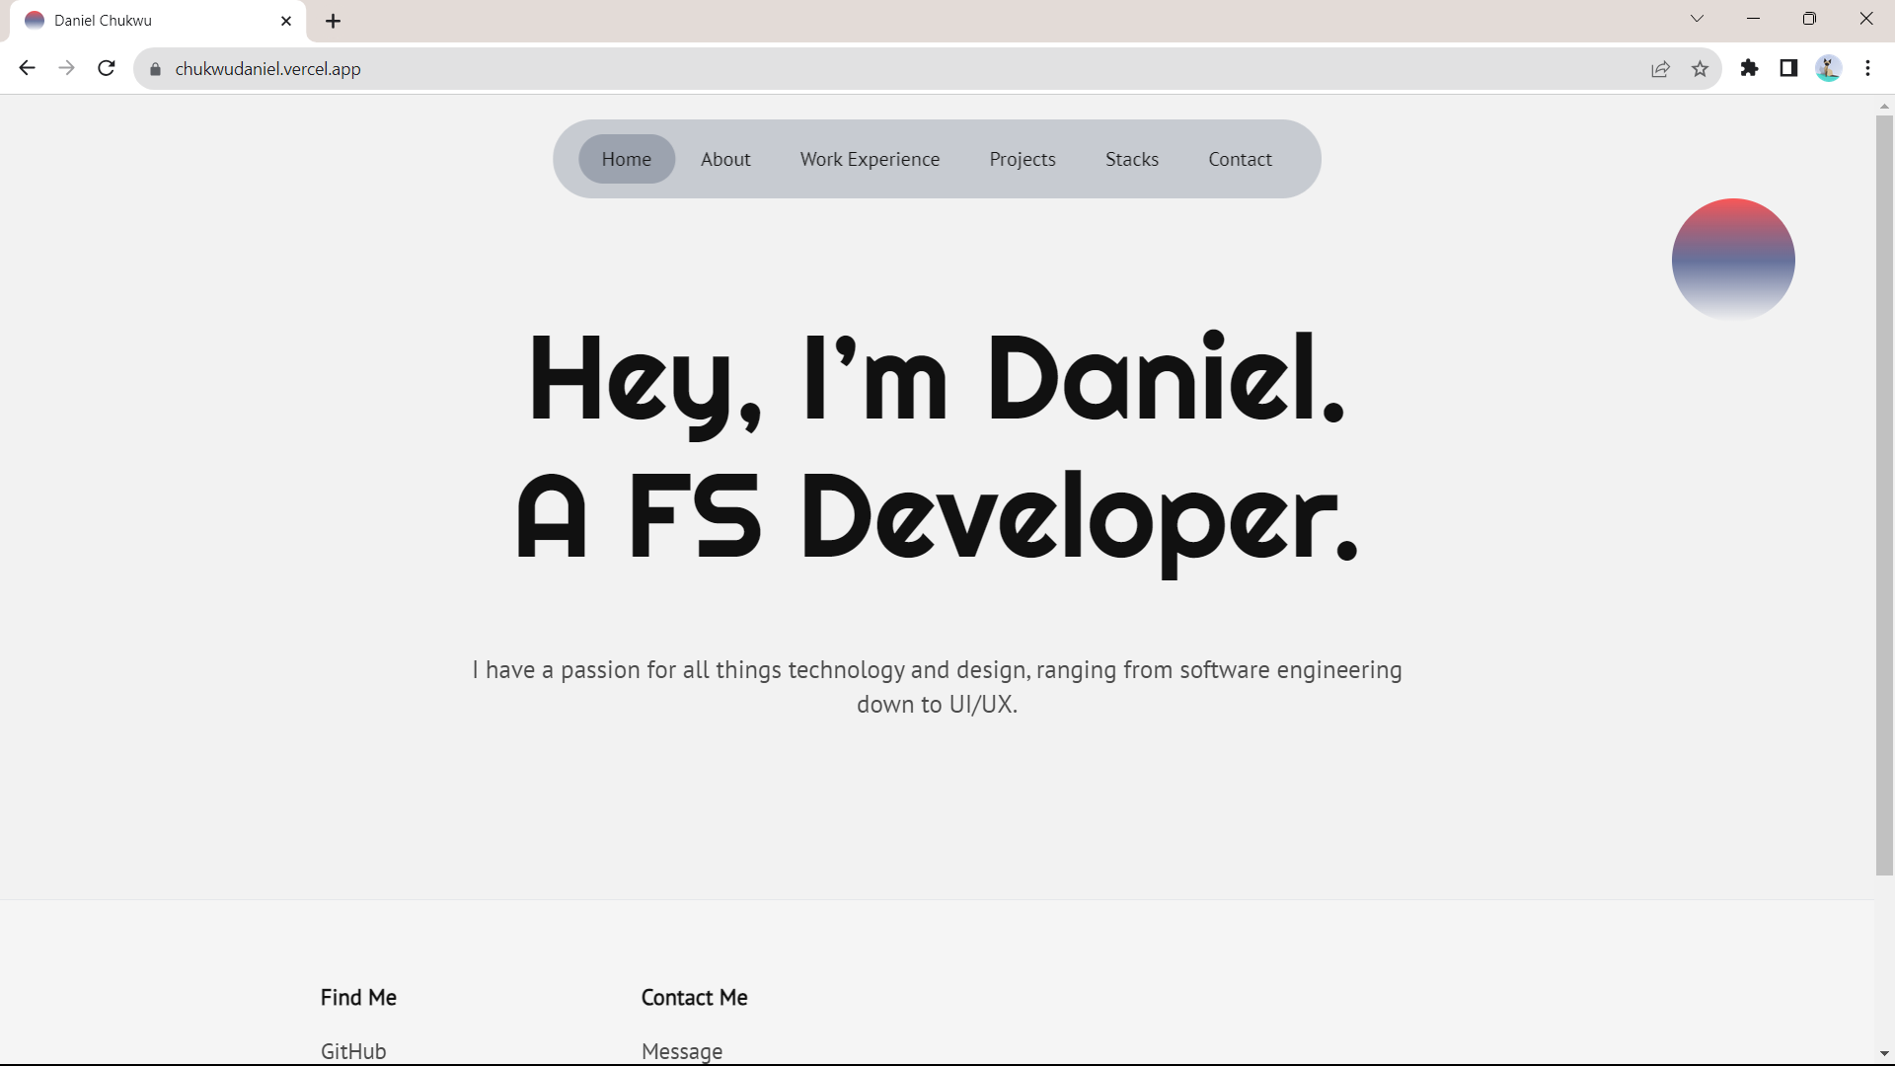
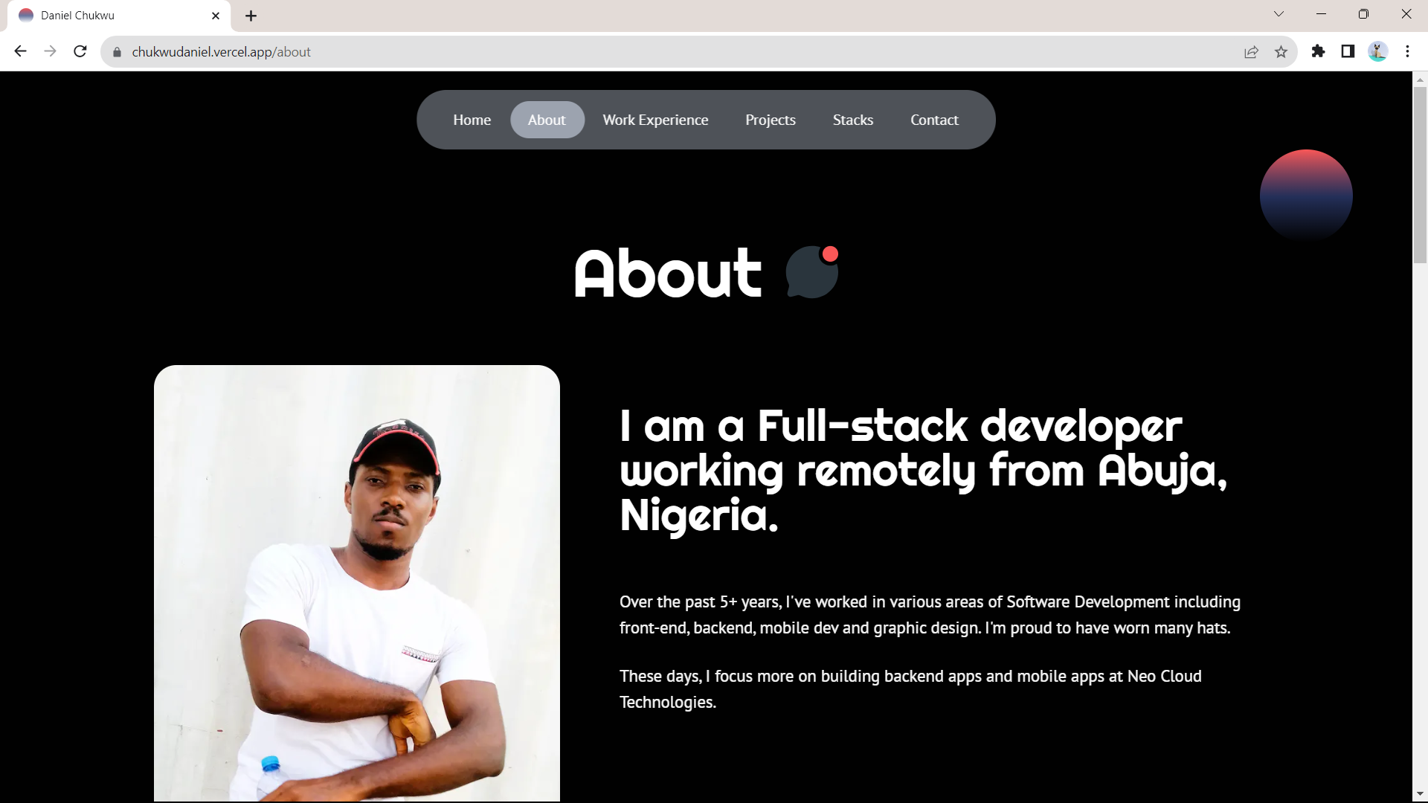
Portfolio Website

Slide 12
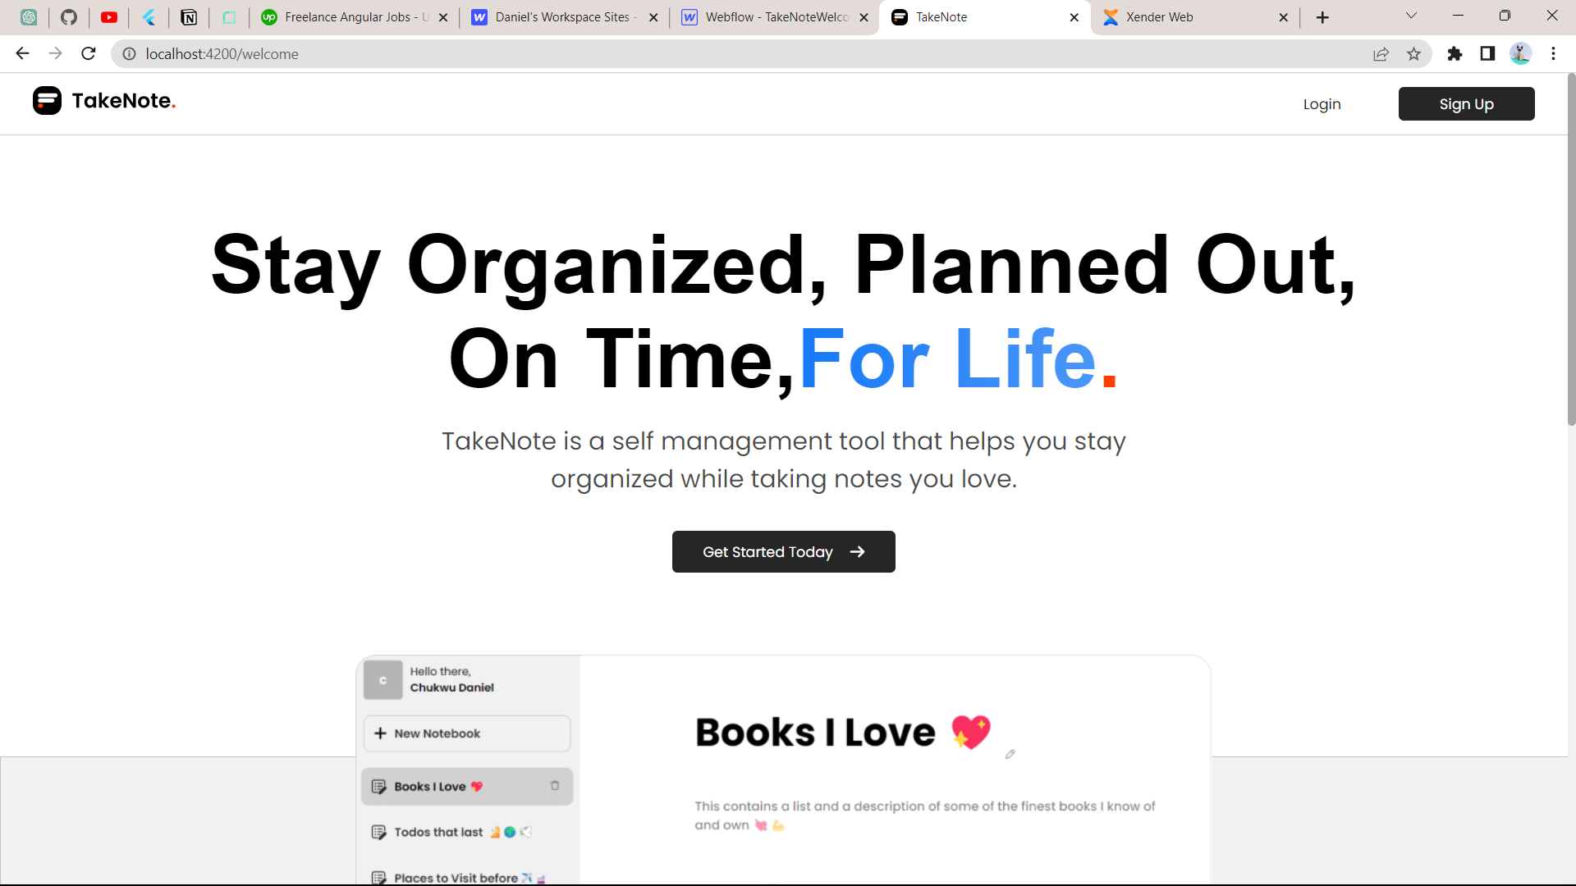
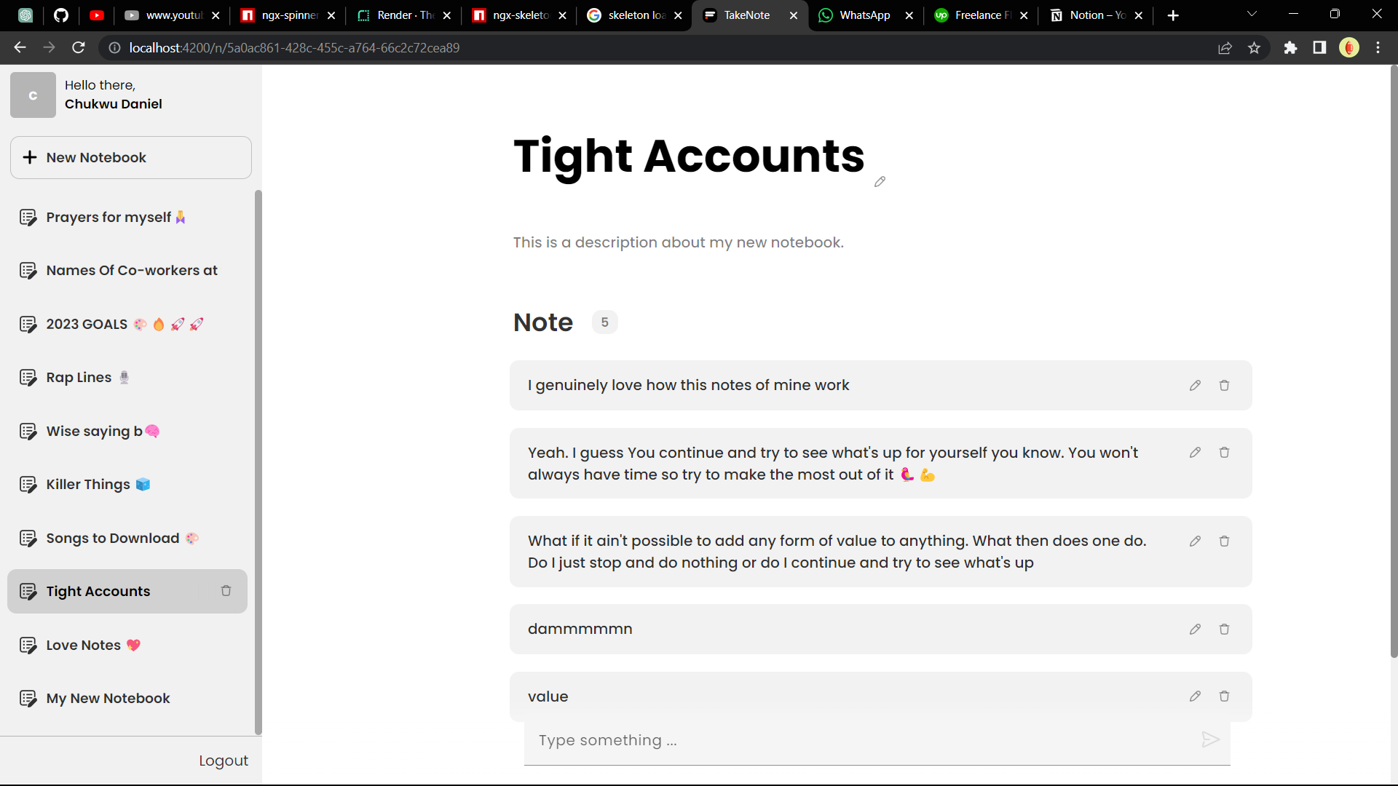
TakeNote. (A Note Taking Web Application)

Slide 13
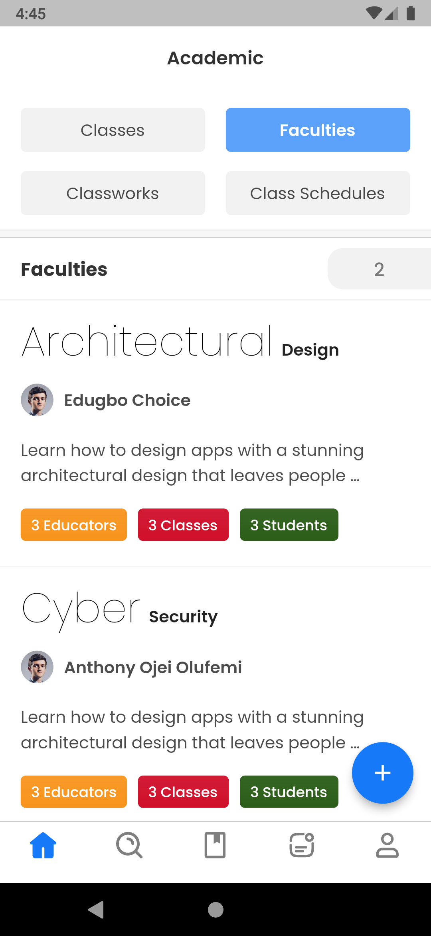
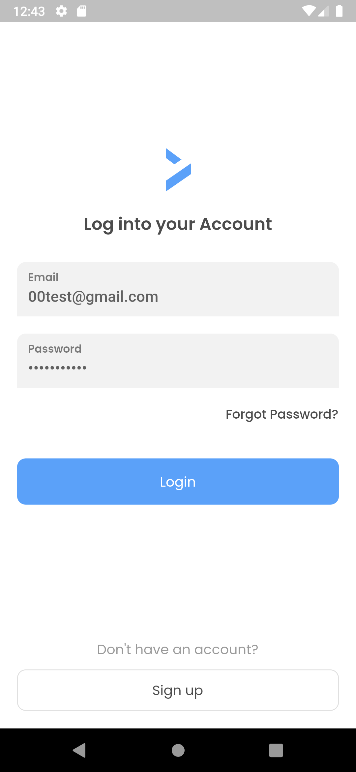
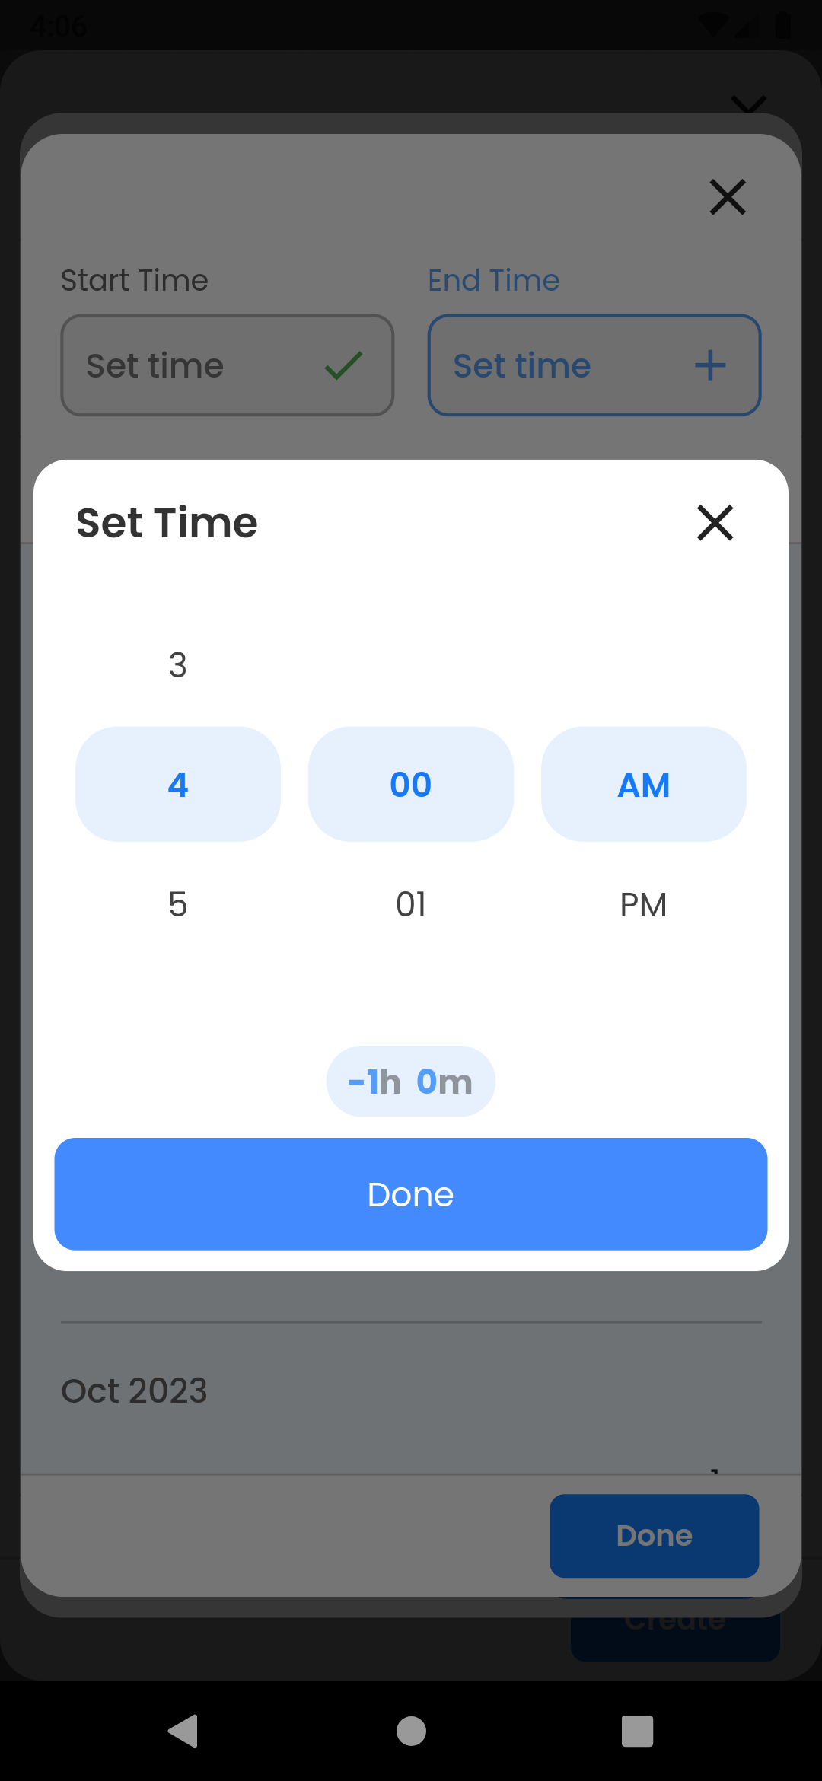
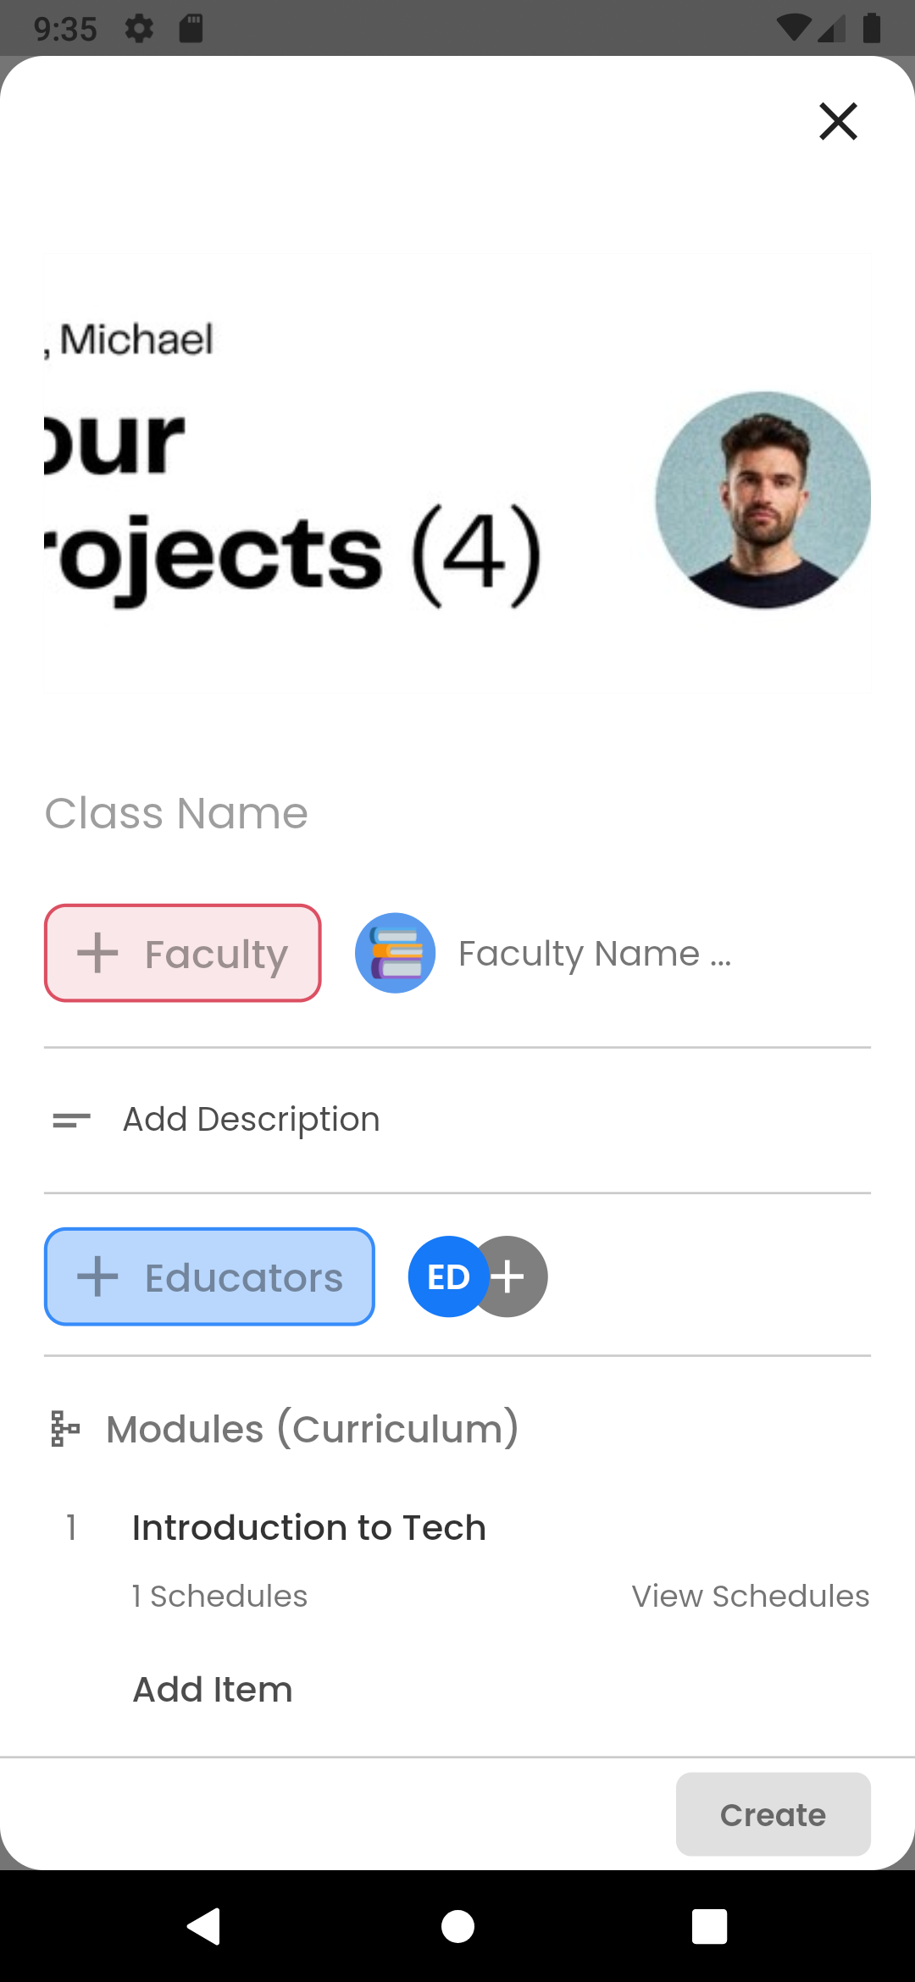
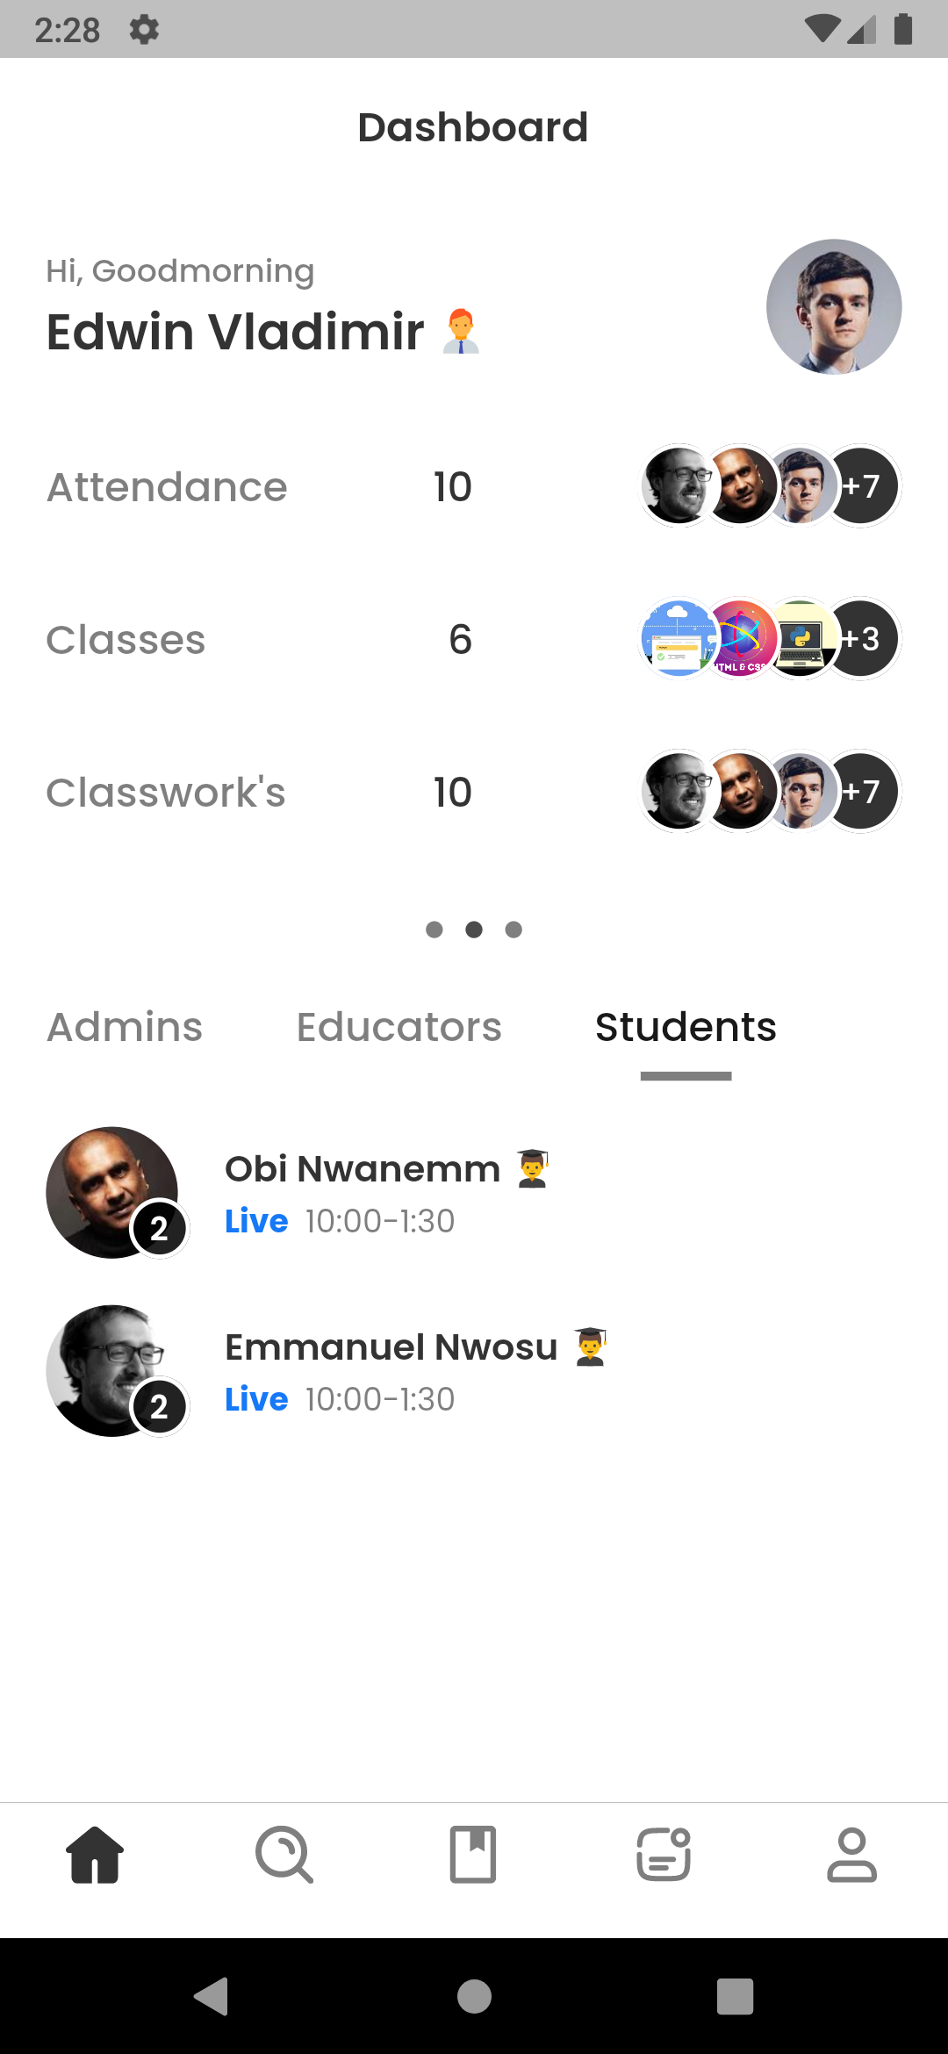
Neo Cloud Mobile Application

Slide 14
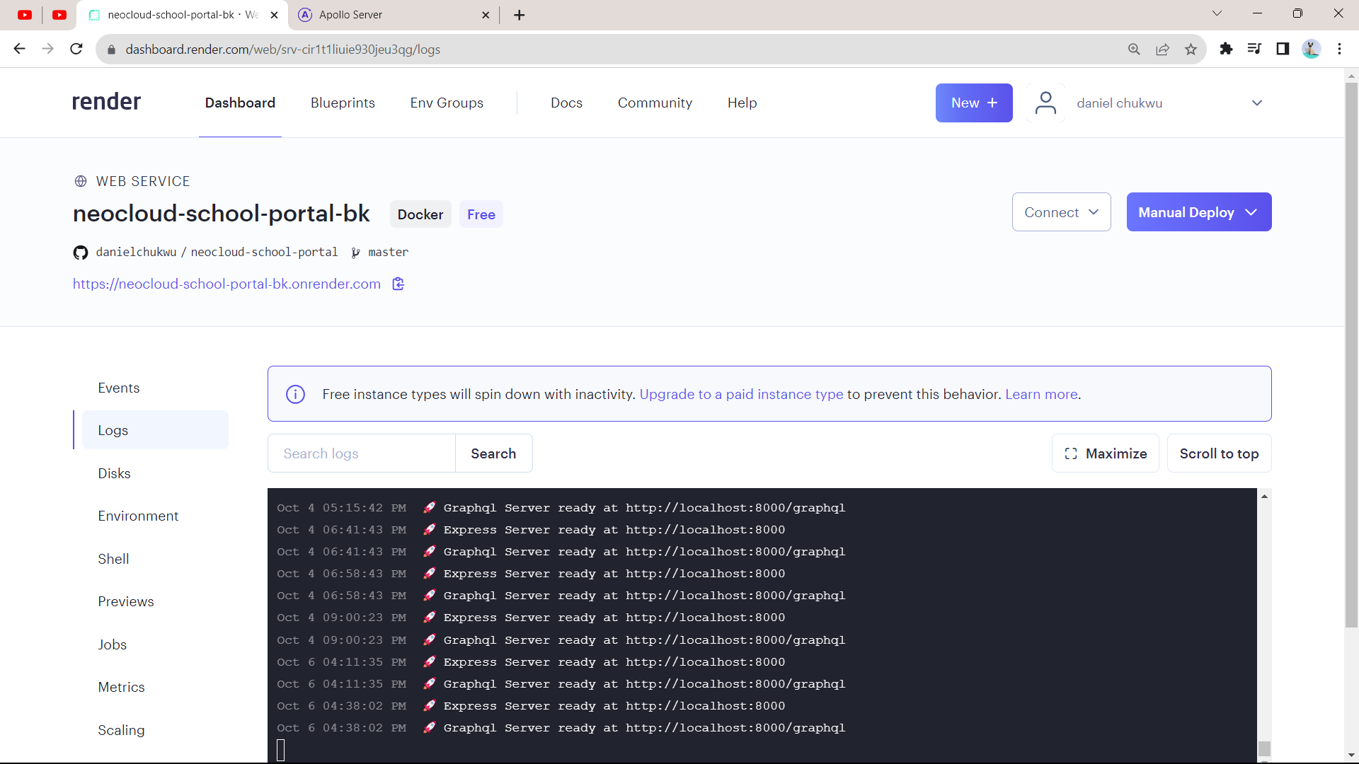
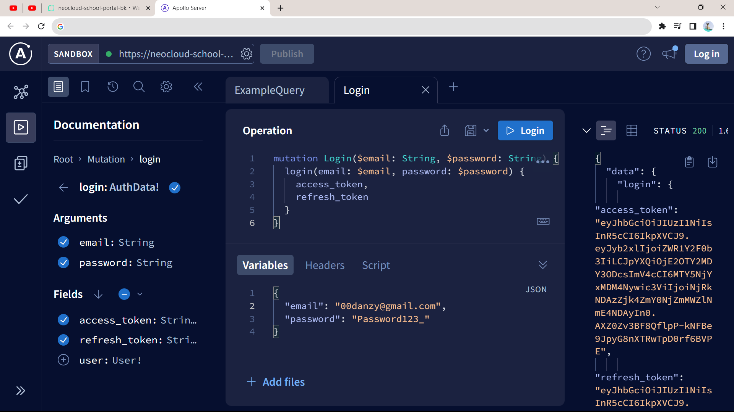
Neo Cloud Mobile Application (Backend)

Slide 15
Takeaways
- Importance of planning projects
- Importance of clean architecture, when building flutter apps
Structuring mobile application projects
Why planning can be important
Why it’s best to follow the agile methodology when creating software solutions
Why the TDD approach to software development is the best approach to software development

Slide 16
Conclusion
My Internship was nothing short of transformative. It equipped me with valuable skills, showing me the dynamic world of technology, exposing me to the work environment and how scary real world problems can be.
I had the privilege of working with multiple technologies to solve problems, contributing to the development of innovative solutions.
Though it was kinda stressful going to work everyday 😅, I’ve to say it was worth it.
Thank You 🙏

